Slide 1

© 2011, Mike Murach & Associates, Inc.
Slide <number>

Slide 2
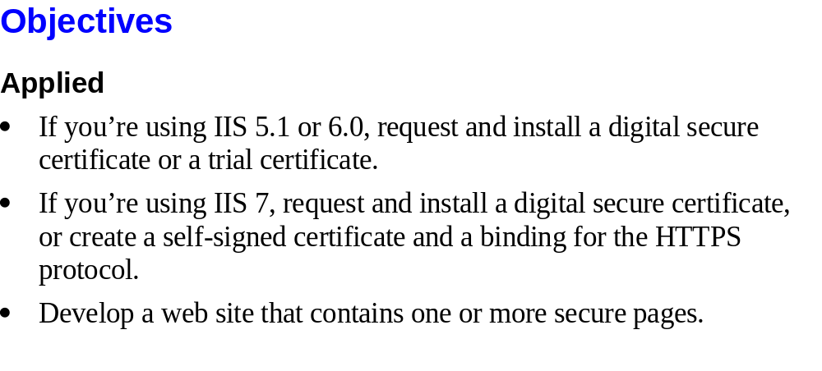
© 2011, Mike Murach & Associates, Inc.
Slide <number>

Slide 3
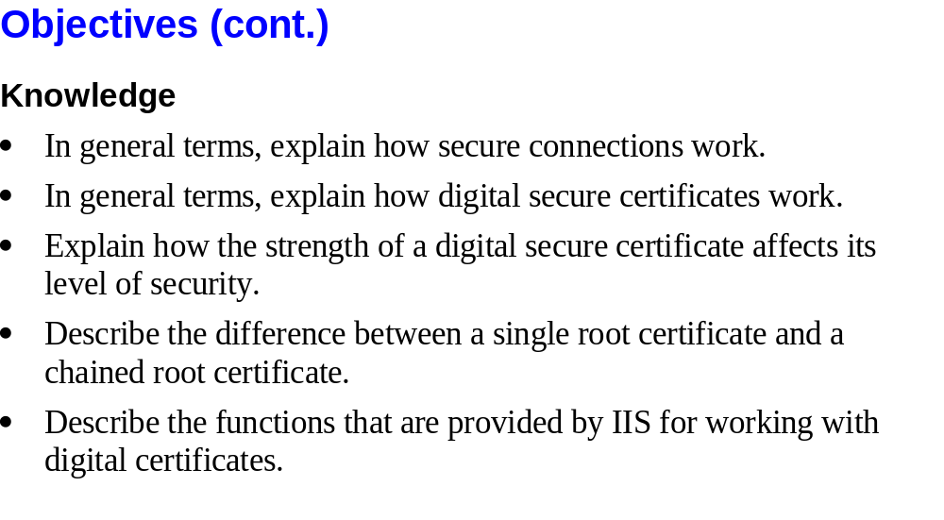
© 2011, Mike Murach & Associates, Inc.
Slide <number>

Slide 4

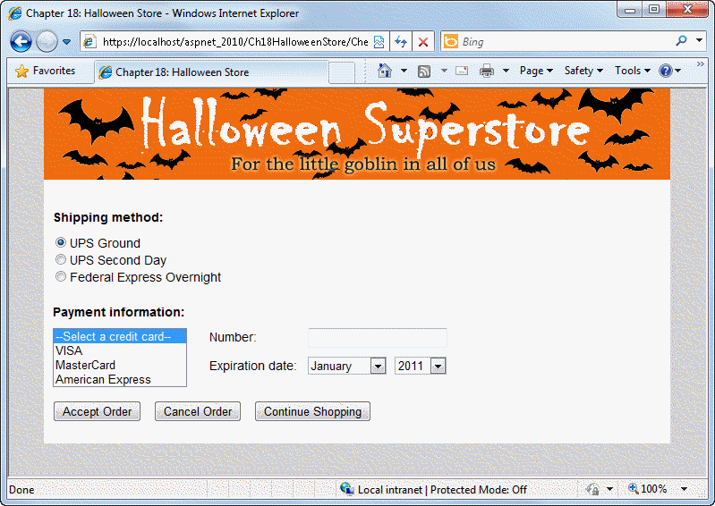
© 2011, Mike Murach & Associates, Inc.
Slide <number>

Slide 5

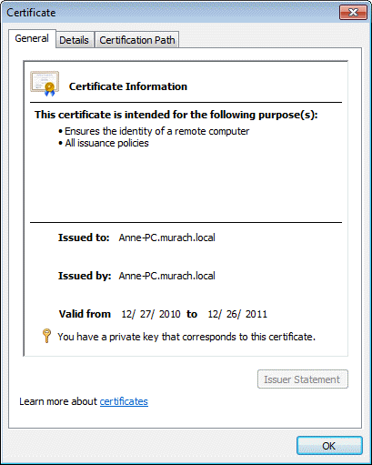
© 2011, Mike Murach & Associates, Inc.
Slide <number>

Slide 6
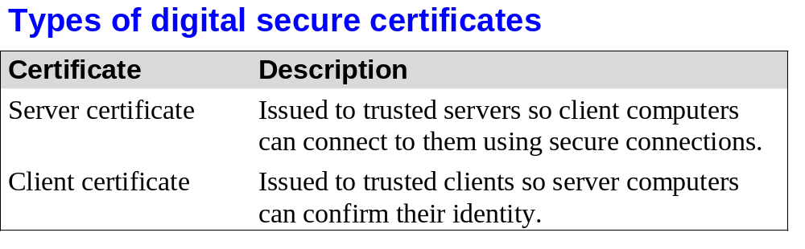
© 2011, Mike Murach & Associates, Inc.
Slide <number>

Slide 7
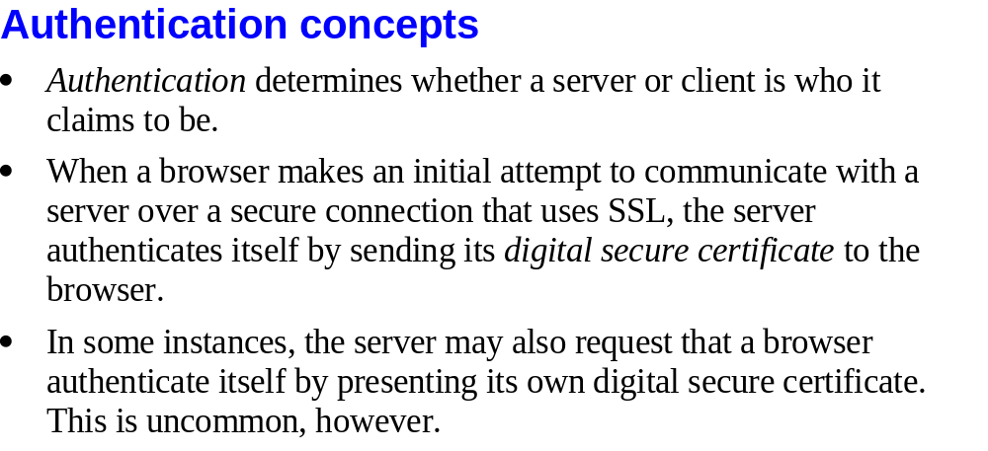
© 2011, Mike Murach & Associates, Inc.
Slide <number>

Slide 8
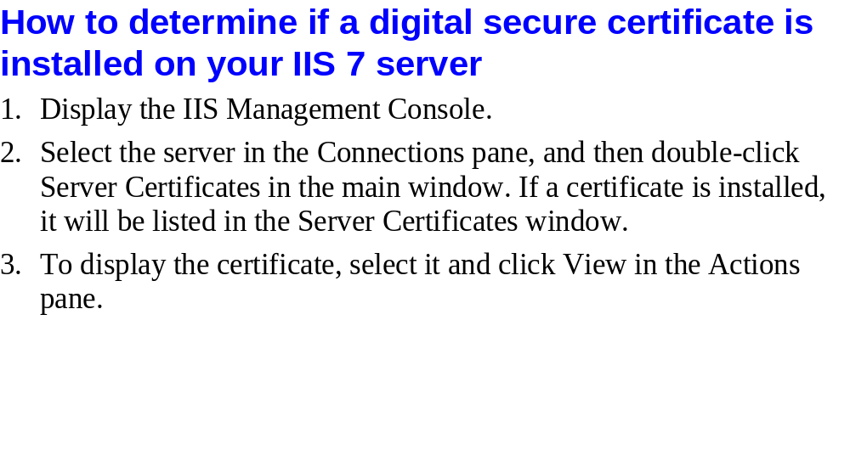
© 2011, Mike Murach & Associates, Inc.
Slide <number>

Slide 9

© 2011, Mike Murach & Associates, Inc.
Slide <number>

Slide 10
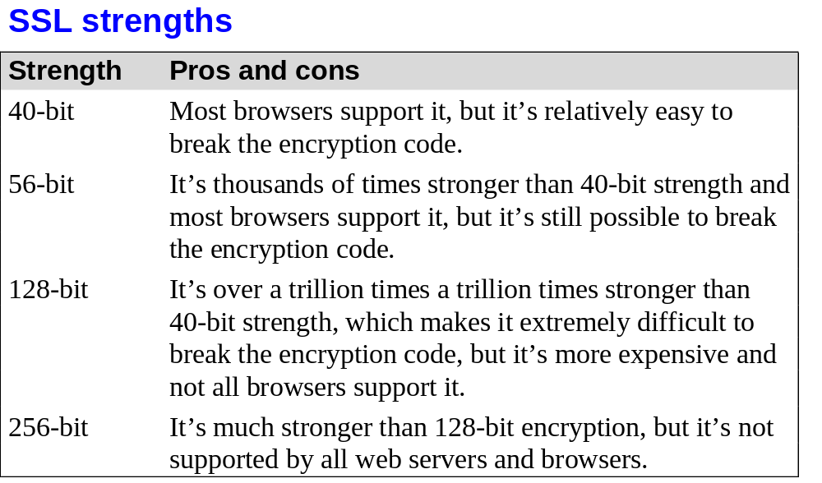
© 2011, Mike Murach & Associates, Inc.
Slide <number>

Slide 11

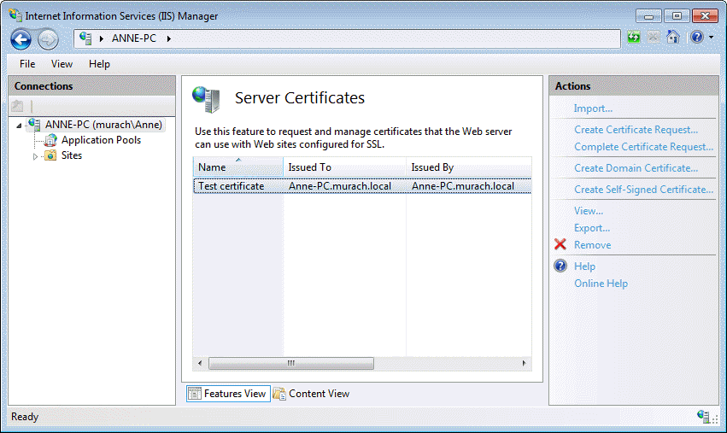
© 2011, Mike Murach & Associates, Inc.
Slide <number>

Slide 12
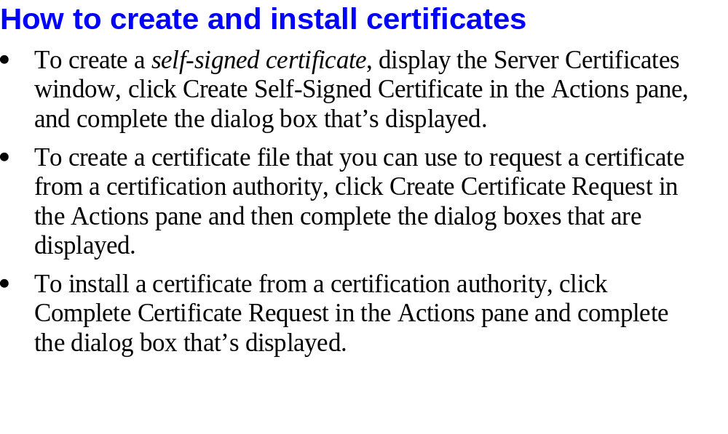
© 2011, Mike Murach & Associates, Inc.
Slide <number>

Slide 13
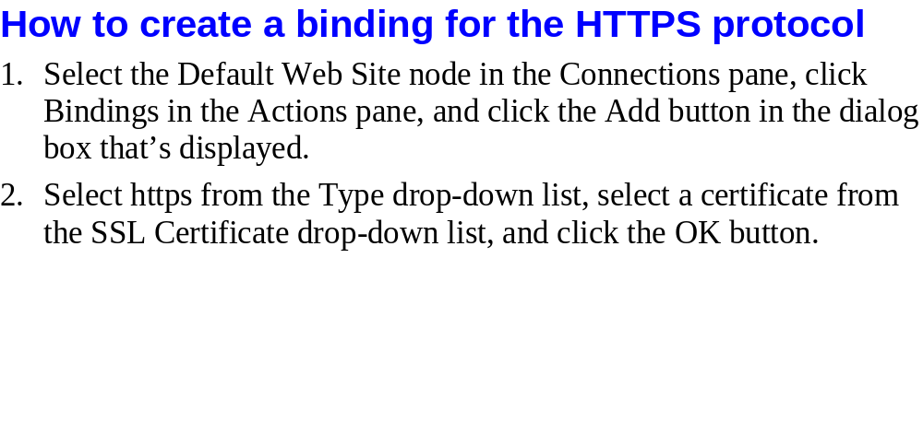
© 2011, Mike Murach & Associates, Inc.
Slide <number>

Slide 14

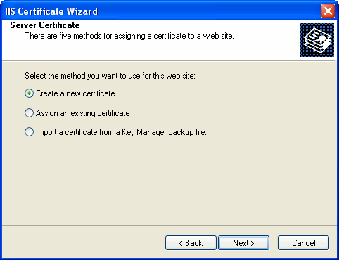
© 2011, Mike Murach & Associates, Inc.
Slide <number>

Slide 15

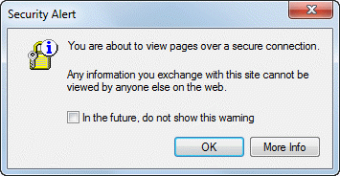

© 2011, Mike Murach & Associates, Inc.
Slide <number>

Slide 16
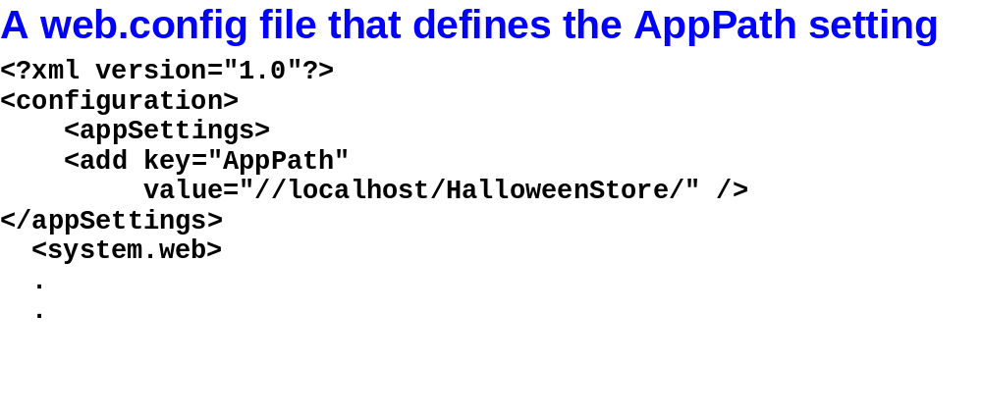
© 2011, Mike Murach & Associates, Inc.
Slide <number>

Slide 17
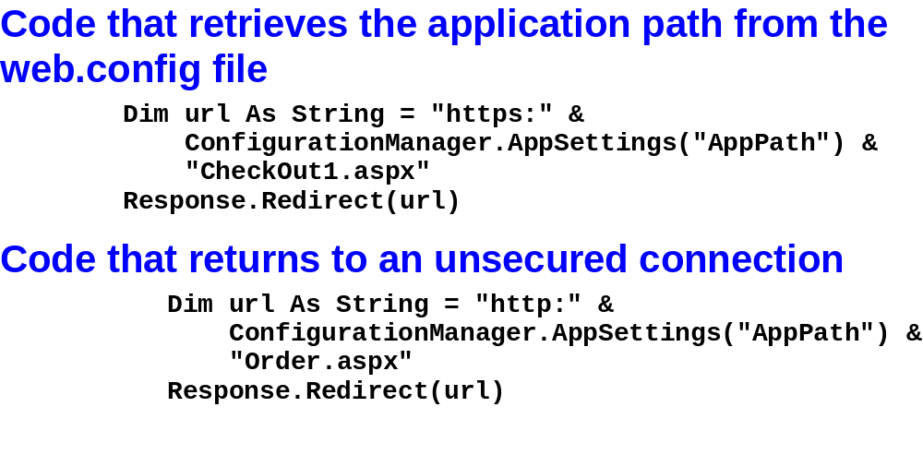
© 2011, Mike Murach & Associates, Inc.
Slide <number>

Slide 18
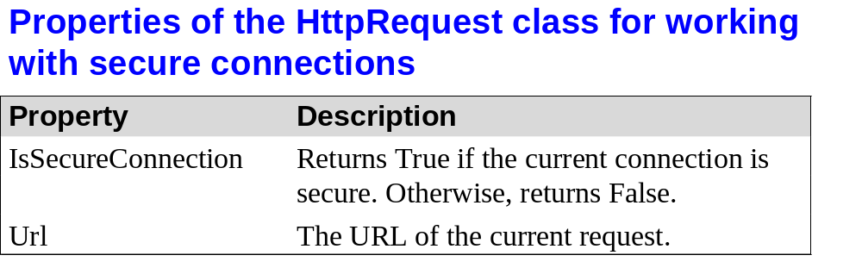
© 2011, Mike Murach & Associates, Inc.
Slide <number>

Slide 19
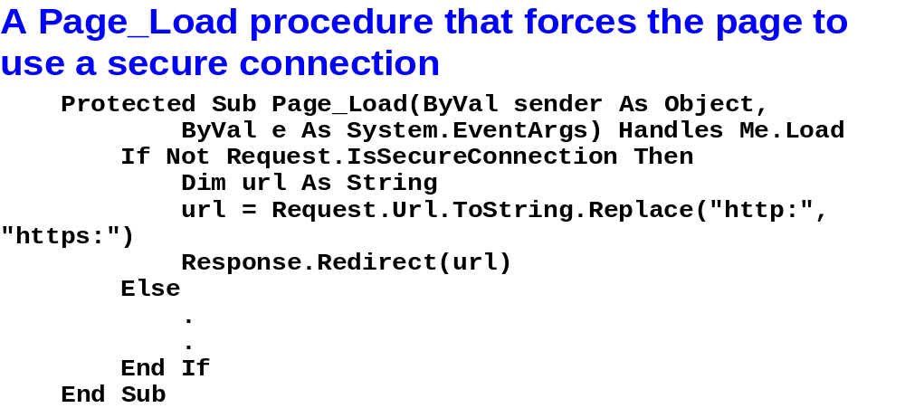
© 2011, Mike Murach & Associates, Inc.
Slide <number>

Slide 20
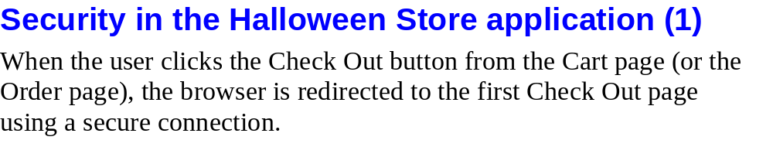
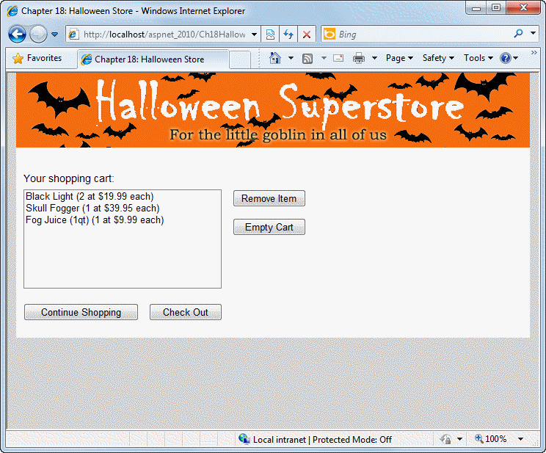
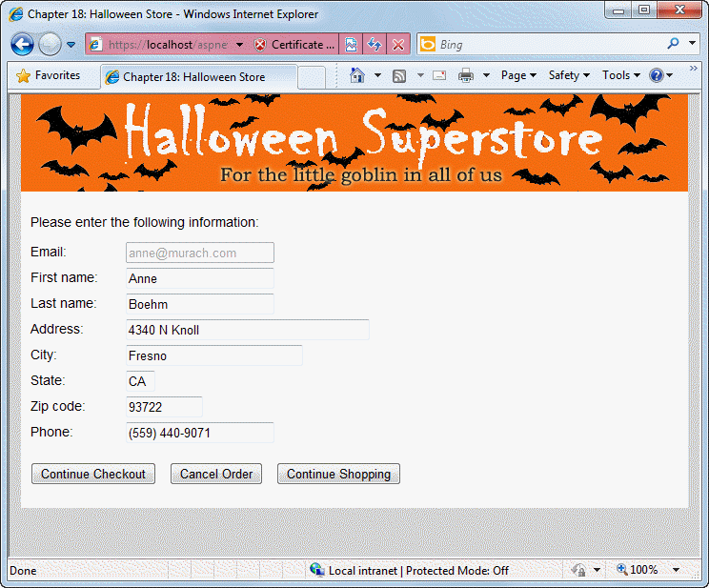
© 2011, Mike Murach & Associates, Inc.
Slide <number>

Slide 21

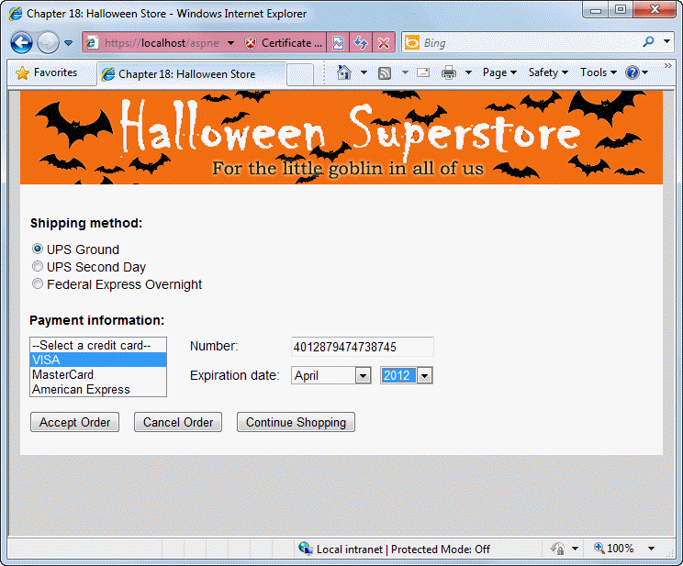
© 2011, Mike Murach & Associates, Inc.
Slide <number>

Slide 22
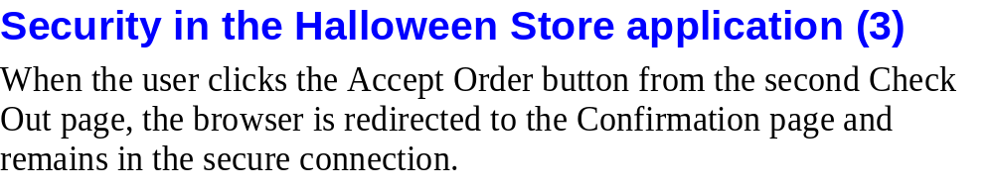
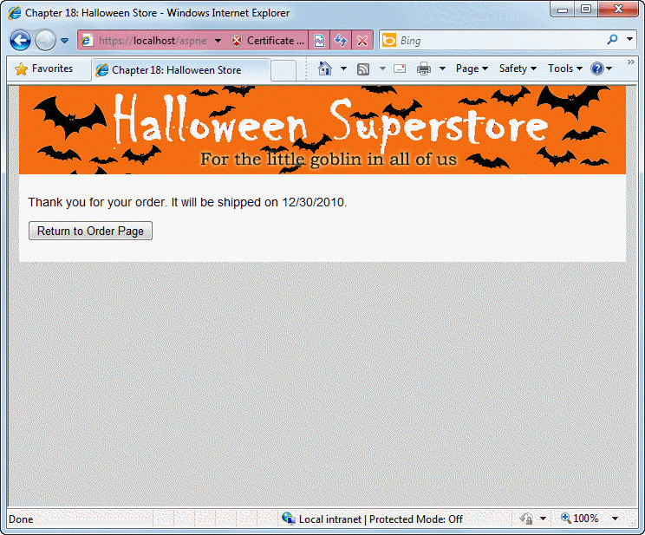
© 2011, Mike Murach & Associates, Inc.
Slide <number>

Slide 23
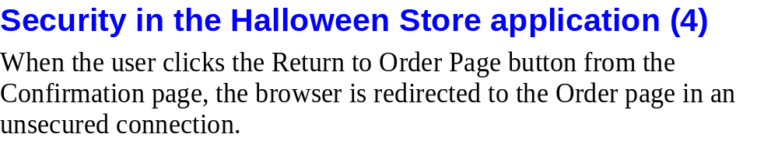
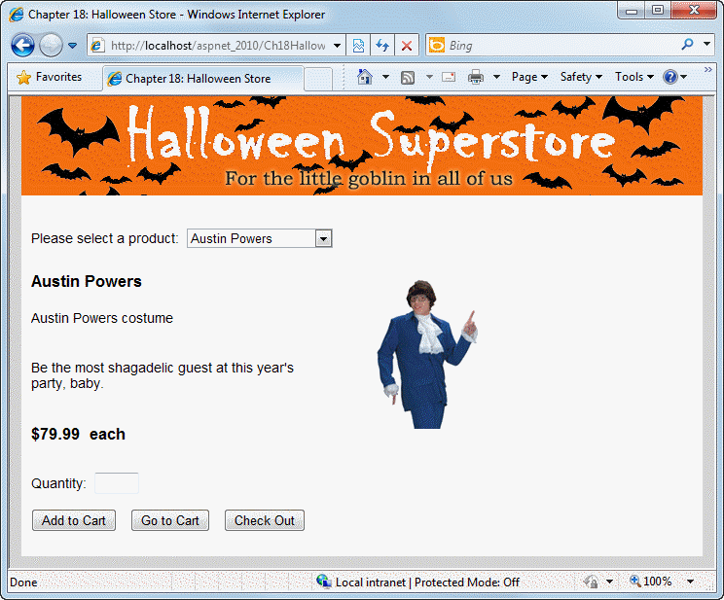
© 2011, Mike Murach & Associates, Inc.
Slide <number>

Slide 24
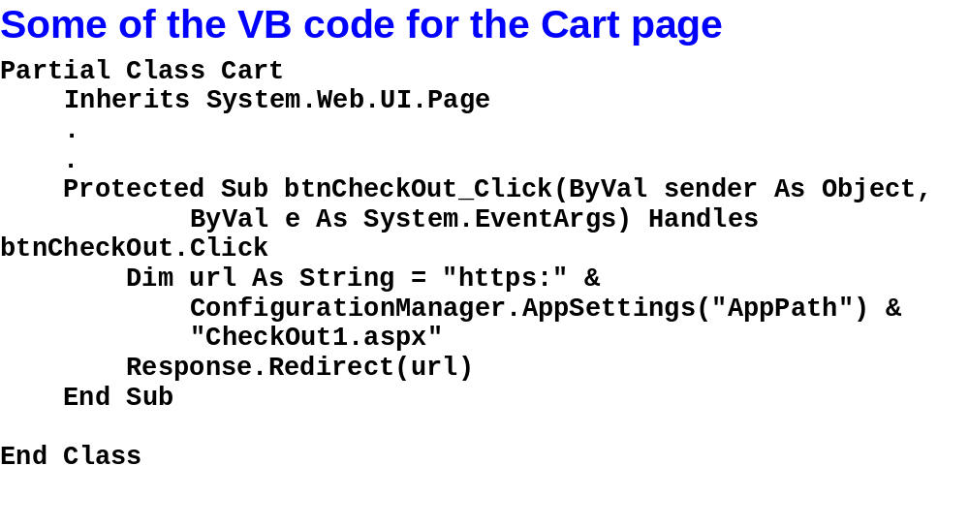
© 2011, Mike Murach & Associates, Inc.
Slide <number>

Slide 25
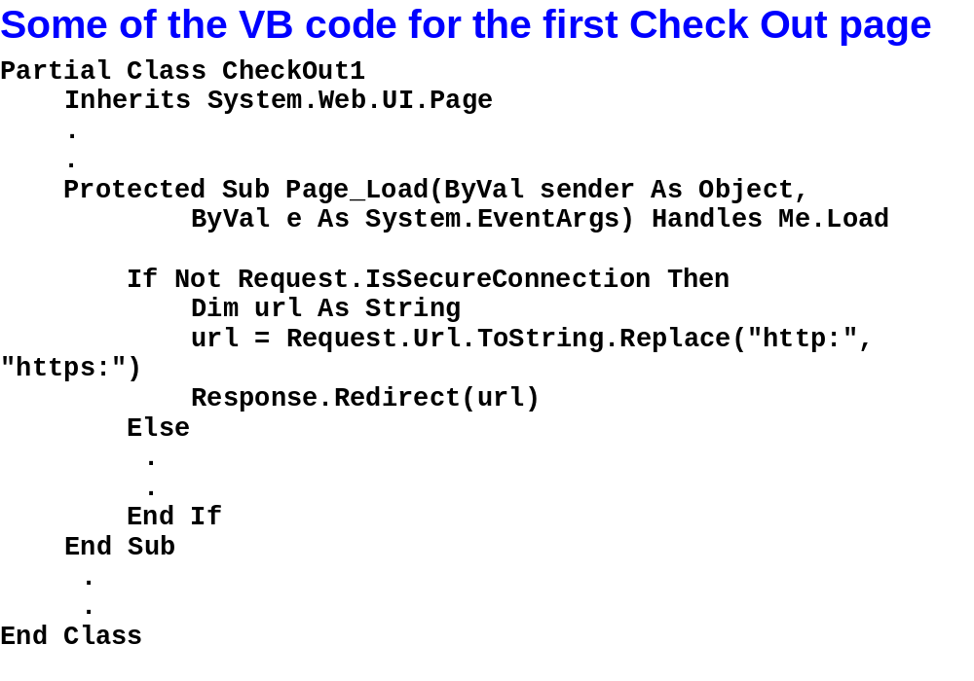
© 2011, Mike Murach & Associates, Inc.
Slide <number>

Slide 26
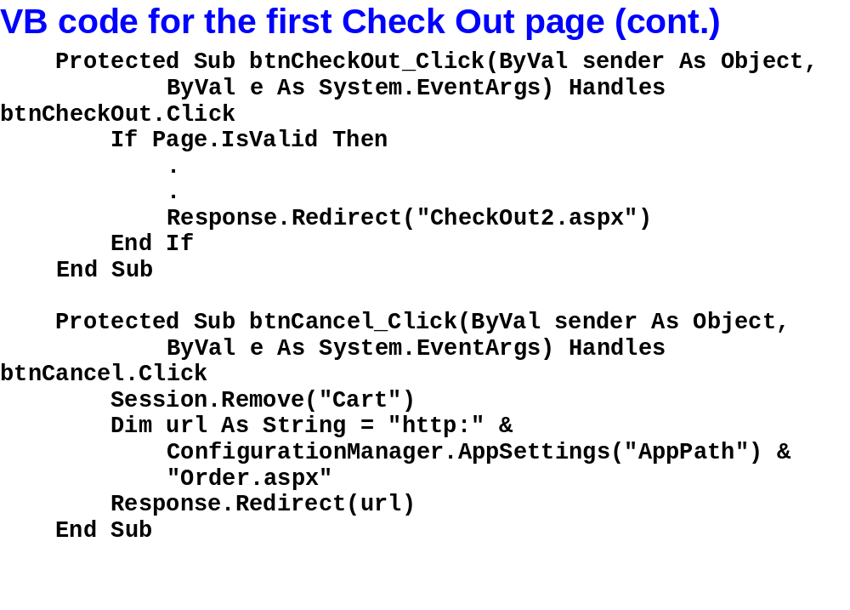
© 2011, Mike Murach & Associates, Inc.
Slide <number>

Slide 27
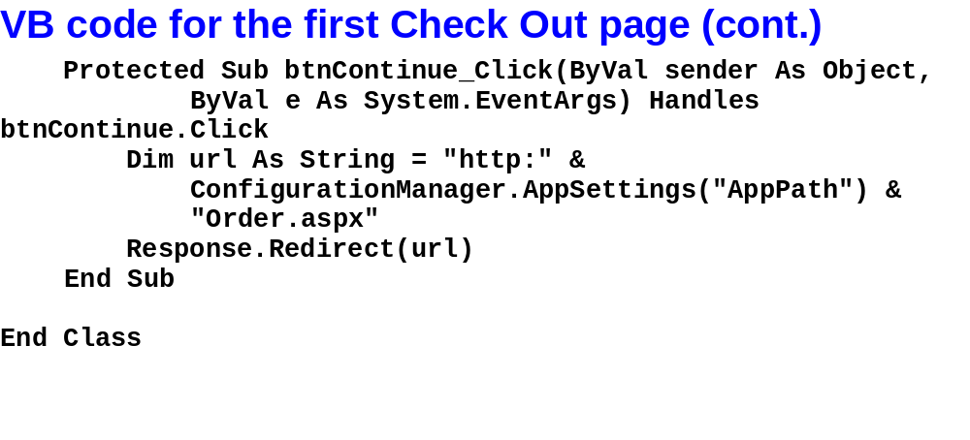
© 2011, Mike Murach & Associates, Inc.
Slide <number>

Slide 28
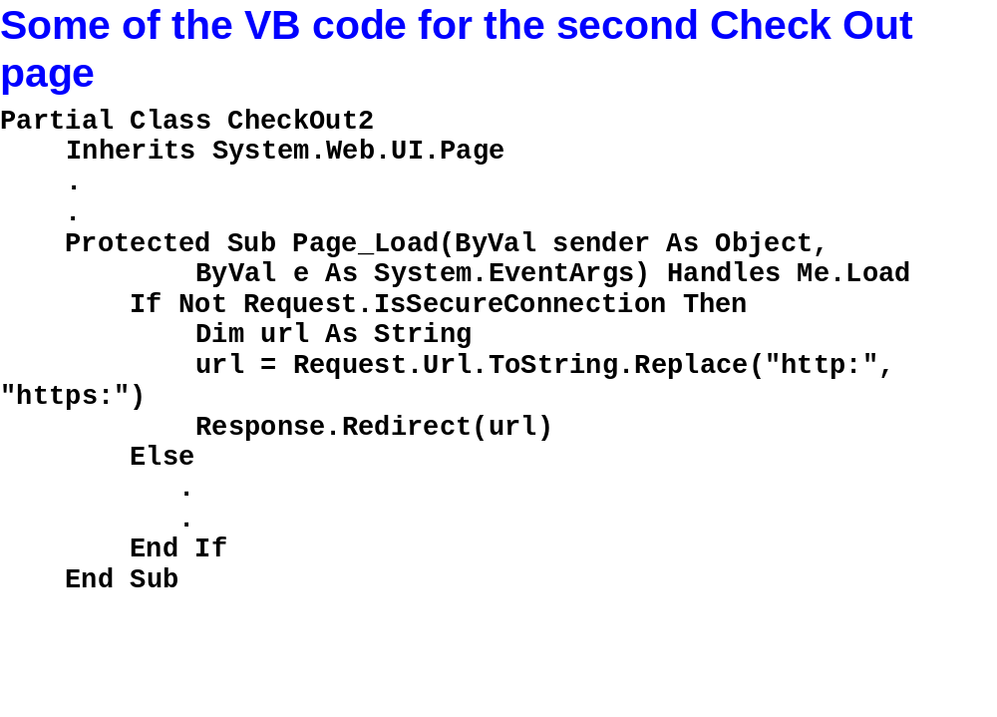
© 2011, Mike Murach & Associates, Inc.
Slide <number>

Slide 29
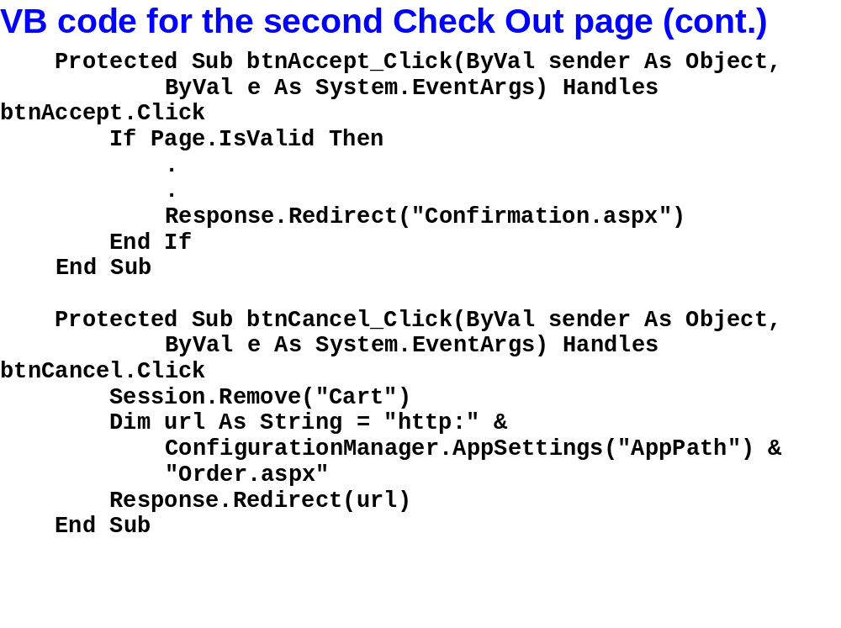
© 2011, Mike Murach & Associates, Inc.
Slide <number>

Slide 30
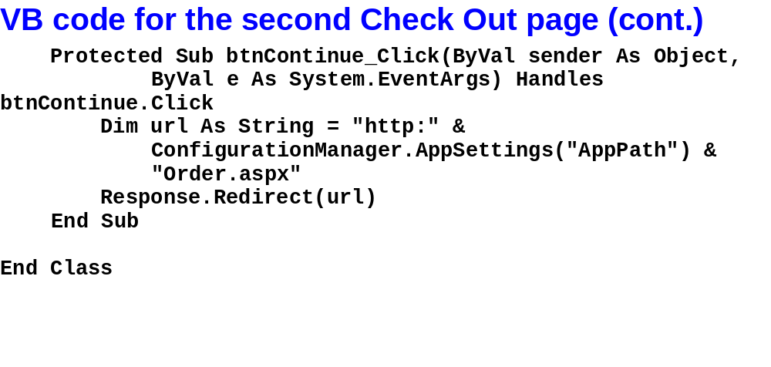
© 2011, Mike Murach & Associates, Inc.
Slide <number>

Slide 31
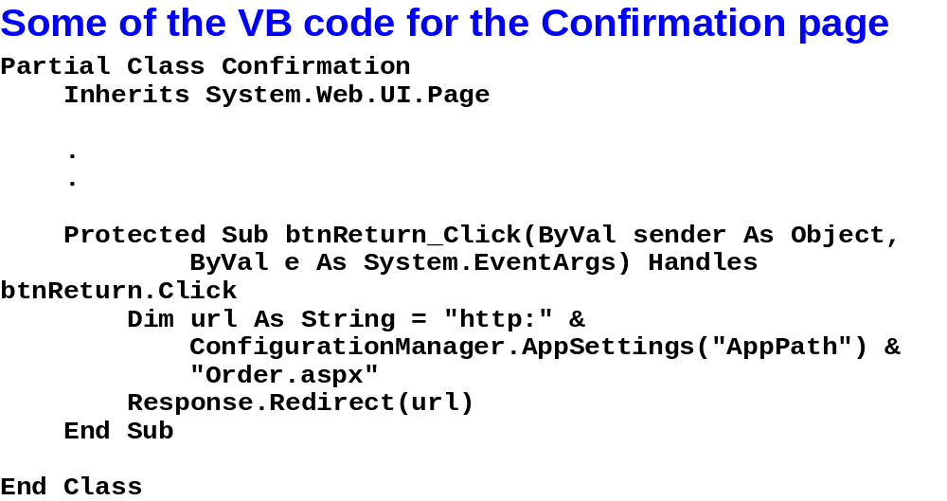
© 2011, Mike Murach & Associates, Inc.
Slide <number>

